Slide 1
ISFS613: DATA
ANALYTICS IN
FINANCIAL SERVICES
Targeted Customer Marketing
Group 8:
Bai Jiacheng
Jiang Nan
Lin Bei
Sun Qiansheng
Yao Yu

Slide 2
Agenda
01
Business Challenges
02
Analysis Approach
03
Data Insight - MVAC Customer Profile
04
Data Insight - Revolver Prediction

Slide 3


Business Challenges

Slide 4
Business Challenges of OCBC
Three Problems OCBC Faced
1. Who are the existing valuable customers?​
Small percentage but generate majority of revenue.​
Revolvers which can contribute nearly 26% interest.
2. How can we retain our valuable customers?​
​
3. How can we generate more revenue?
Notes:
OCBC has rich credit card data and excellent reputation. However, competitive market campaigns make OCBC need to know more about their customersretaining the valuable customers. In the meanwhile, OCBC analyst needs to balance the revenue and the risk.
We want to find out the customers based on the volumn of the data, hope that we can find out some special pattern.

Slide 5

Solution Overview
Notes:
Therefore, we hope we can help ocbc to achieve two objectives: one is to predict the revolver (increase the revenue). the second one know our customers and retain them.[cross sell and up sell]

Slide 6
Solution Overview
Revolver Customer
Prediction
Customer Demography
And Transaction
Data
Understand Customer Profile
And Do Target Marketing
Retain Customers and Generate More Revenue
MVAC
RFM
Clustering
Association
Analysis
Notes:
RFM Model ：
Differentiate the middle value but active customer from the transaction data set. (MVAC)
After that, we try to analyze and conclude the pattern of MVAC and use clustering and MBA analysis to deep dive into some high value groups from there.
Revolver Prediction
Allow bank pre-predict revolver flag of new customer based on their transaction data and profile.
We only predict hard revolvers, because the hard revolvers will have more unique pattern and generate more interest after balancing with the risk.

Slide 7

MVAC Customer Profiles
Notes:
Then, lets have a general idea of what is MVAC customer.

Slide 8
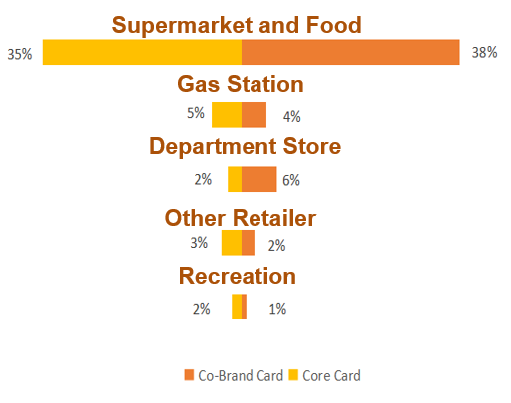
MVAC (MEDIAN VALUE AND ACTIVE CUSTOMER)
MVACs occupied 15% of the overall customers, but accounts for more than 50% of the total transactions.
Gender
Age 30-49 are the main power.
58%
42%
The Total Spending Pattern grouped
by card type:
Notes:
MVAC are extract from RFM model with high frequency and median level transaction amounts.
The gender is half half. They are more in middle age and spend more on life needs.

Slide 9
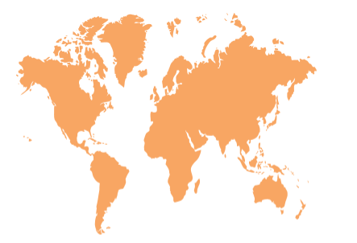

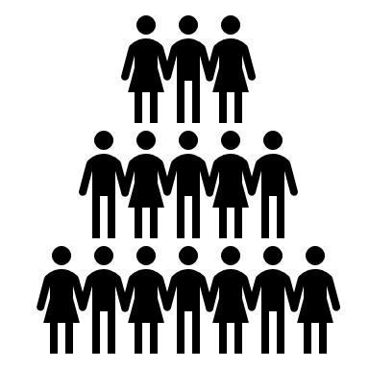
MVAC: INSIGHTS
$ 37 million
Per Annual
Spending Increase
$2935
Average Spending
Per Customer
​
3163
Median Value Active
Customers
Notes:
For MVAC, they spend $2935 in average per quartar. And we have 3163 projected customers. Therefore, they can generate more than 37 million dollars per year

Slide 10
Customer Segmentation of MVAC
After clustering, we extract the most valuable car owners.
 | Car Owners
 | 8%
 | 90% spent on gas station and food Male 50-70 years old above 30%Revolver
Notes:
After we find out MVAC customers are really the valuable, we think ocbc should retain, we wanna know what kind of accurate targeting measure can be taken in these group. We use k-means clustering to deal with the MVAC customers and find out one special cluster who are all car owners.
The main feature of the car owners are :…..

Slide 11
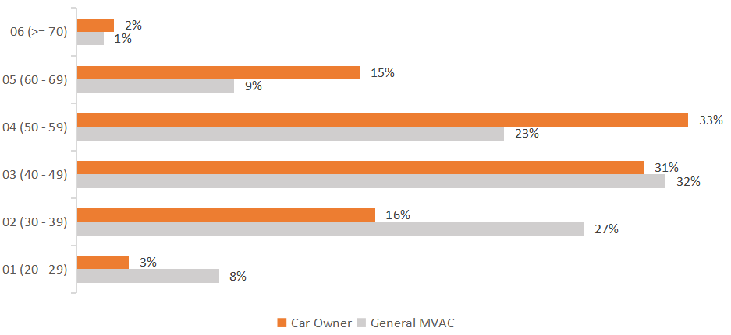
Target Demographic of Car Owners
Past Middle Age Male
Car Owner
Overall Demographic vs Car Owner Population
Stable Income and more likely to have
requirements on cars.
More likely to purchase car related products.

Slide 12





Car Owners :
Association Analysis and Expected Revenue
Confidence > 50%
Supermarket
Online Retailer
Department Store
$ 542 AVERAGE SPEND ​
PER CUSTOMER​ PER MONTH
$1.95 million
PER ANNUAL SPEND INCREASED
Notes:
We set confidence more than 50%, which mean they are more convincing.
After the people go to gas station like esso and caltex, they are more likely to spend on life spending.
For specific car owners, they spend $542 in average per quartar. hey can generate more than 1.95 million dollars per year

Slide 13





Retain Customers:
Special Discount for Car Owners
Rewards​ | Merchant Name
Online Shopping 10% off Discount for first users
Double Credit when reach minimum
$20 Voucher at ISETAN
Extra 5% Discount ​for Fair Price and Giant
Notes:
Therefore, we have two ways to deal with these valuable customers, one is trying to retain them by offering them special discounts no matter on gas station or the store they may head to after the gas station.

Slide 14

Cross-Sell: Autowise Car Insurance
Insurance is the most important
resources of revenue.
Telephone/SMS target promotion:
‘AUTOWISE’ Car Safety Insurance.
Implement Insurance in Core Card. Providing one year Free Insurance for Car owners with first purchase
Notes:
The another way is do cross sell to these group. We can offer them car insurance which OCBC now promoted.'Autowise' . Since, they all are car owners and frequently use car. They are more likely to face car problems, these will quite fit their preference.
We hope we can do telephone/sms promotion on them.. And offer them one year free usage as the first purchase if they apply for the new co-brand or core card.

Slide 15
Revolver Prediction

Slide 16
REVOLVER CUSTOMERS
Why Revolver Customer?
Revolvers: Important Source of Revenues
28% of Total Customers are Revolvers.
$1942 Average Spend per Revolvers
Features:
Age 30 to 60.
Main spending patterns are daily expenses
Most credit limit under 20K.
Notes:
Revolvers are consumers who carry credit card balances from one month to the next. Revolvers as a group are important sources of revenue since they pay interest on their balances. Thus, we try to predict revolver labels of new customers and make revolver segmentation to improve revenues of the bank.
In this dataset, there are over 8 thousand revolver customers and about 120 thousand transactions are made by revolver customers. Revolver customers spend mainly on daily expenses such as food, clothes and gas. Most revolver customers have credit limits under 20 thousand and age range of active revolvers is from 30 to 60 years old.
We try to predict revolver labels of new customers and make revolver segmentation to improve revenues of the bank.

Slide 17
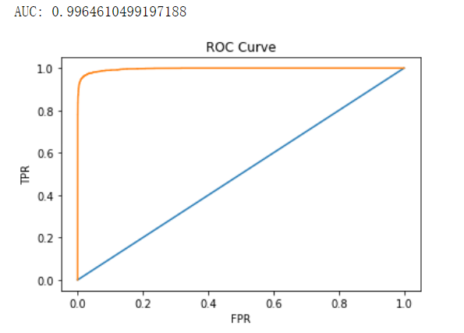
REVOLVER CUSTOMERS
Accuracy: 85%
AUC: 0.996

Slide 18
REVOLVER CUSTOMERS
1. Data transformation and feature Engineering:
2. Target Variable: Hard revolver
3. Best Model: Random Forest.
Recommendations
Customer Acquisition:
Target new customers who are possible the revolver by using predictive modelling.
Customer Retention:
Reward the hard revolvers who do minimum monthly
payment.
Notes:
1. Data transformation and feature Engineering:
a. Join Demographics and Transaction data and select rows with transactor and hard revolver labels
b. Groupby ID and do some aggregations
c. Important feature: Average daily spending amount for each merchant categories and card type, Average daily spending amount for all transactions
2. Binary Classification: "1" means hard revolver. "0" means transactors.
The reason why we predict hard revolver is we think the features of hard revolver and occa/middle revolvers are different. Even the hard revolver is risky, they still are majority of the revolvers and can generate more revenue based on their transaction.
3. Best Model: Random Forest. Other models used: Decision Tree, SVM, AdaBoost.

Slide 19
Q&A

